Slide 1





UCD Dignity and Respect Support Service is here to support students, employees and members of the UCD community.
We offer:
Confidential and unbiased support
Trauma-aware and person-led support
Proactive support in exploring informal resolutions
Guidance and support throughout a formal complaint process

Slide 2
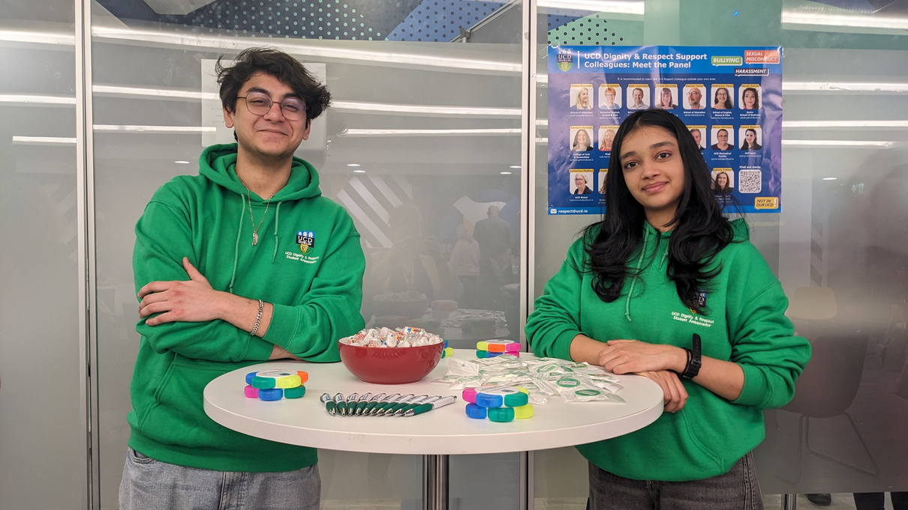





3 ways
to connect with us
Be an Active Bystander:
Take the training!
Stop by our stands across campus during orientation week and throughout the term to connect with our Student Ambassadors!
Follow us on Insta
for exciting giveaways, helpful information and opportunities to interact!
To receive support, email respect@ucd.ie

